Slide 1
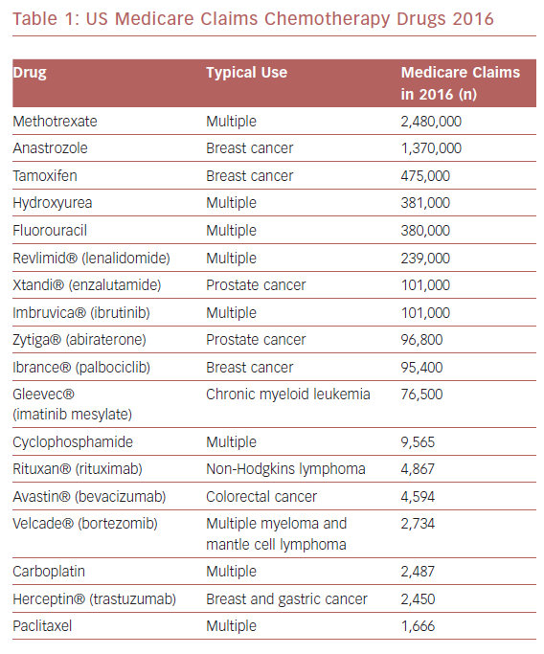
Storey K, Sharkey SW
US Medicare Claims Chemotherapy Drugs 2016
Citation: US Cardiology Review 2019;13(2):74–82.
https://doi.org/10.15420/usc.2019.10.1

