Slide 1
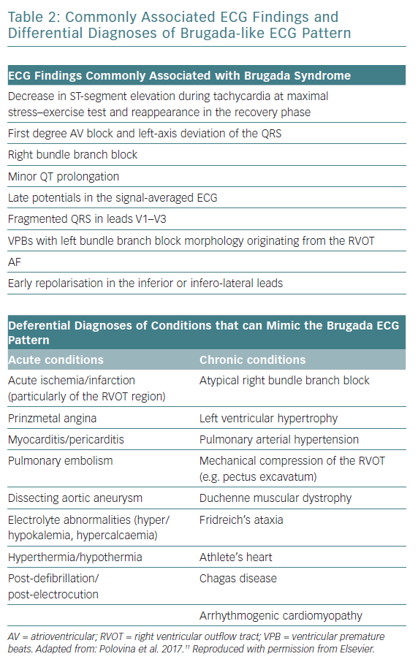
Snir AD, Raju H
Commonly Associated ECG Findings and Differential Diagnoses
Citation: European Cardiology Review 2019;14(3):169–74
https://doi.org/10.15420/ecr.2019.12.2

