Slide 1
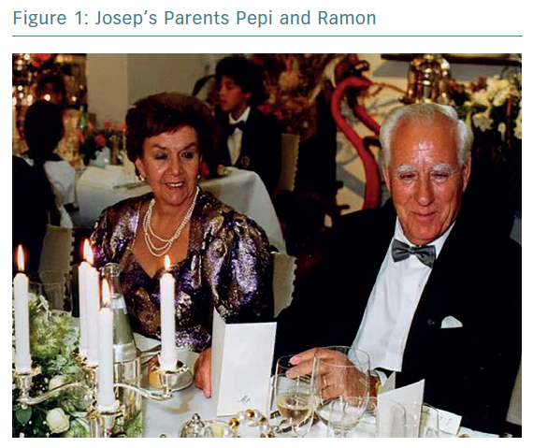
Brugada J
Josep’s Parents Pepi and Ramon
Citation: European Cardiology Review 2019;14(3):197–200
https://doi.org/10.15420/ecr.2019.14.3.CM1

