Slide 1
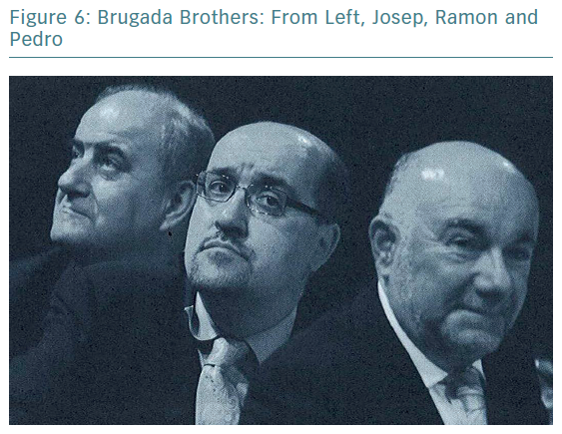
Brugada J
Brugada Brothers: From Left, Josep, Ramon and Pedro
Citation: European Cardiology Review 2019;14(3):197–200
https://doi.org/10.15420/ecr.2019.14.3.CM1

