Slide 1
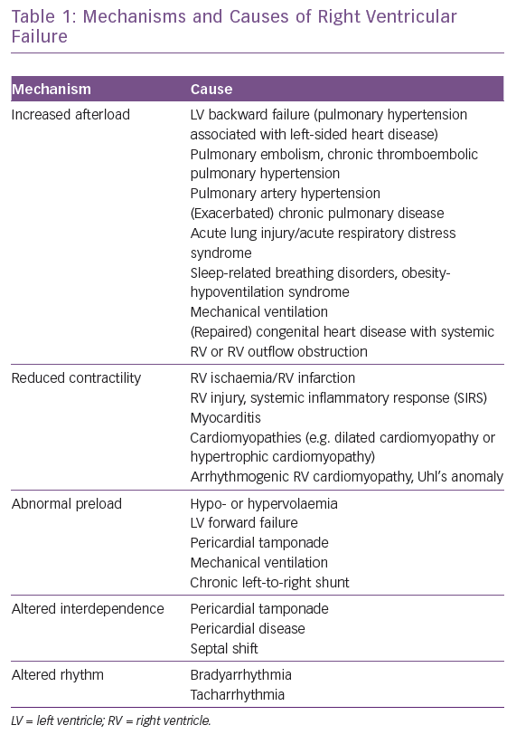
Arrigo M, Huber LC, Winnik S, Mikulicic F, Guidetti F, Frank M, Flammer AJ, Ruschitzka F
Mechanisms and Causes of Right Ventricular Failure
Citation: Cardiac Failure Review 2019;5(3):140–6.
https://doi.org/10.15420/cfr.2019.15.2

