Slide 1
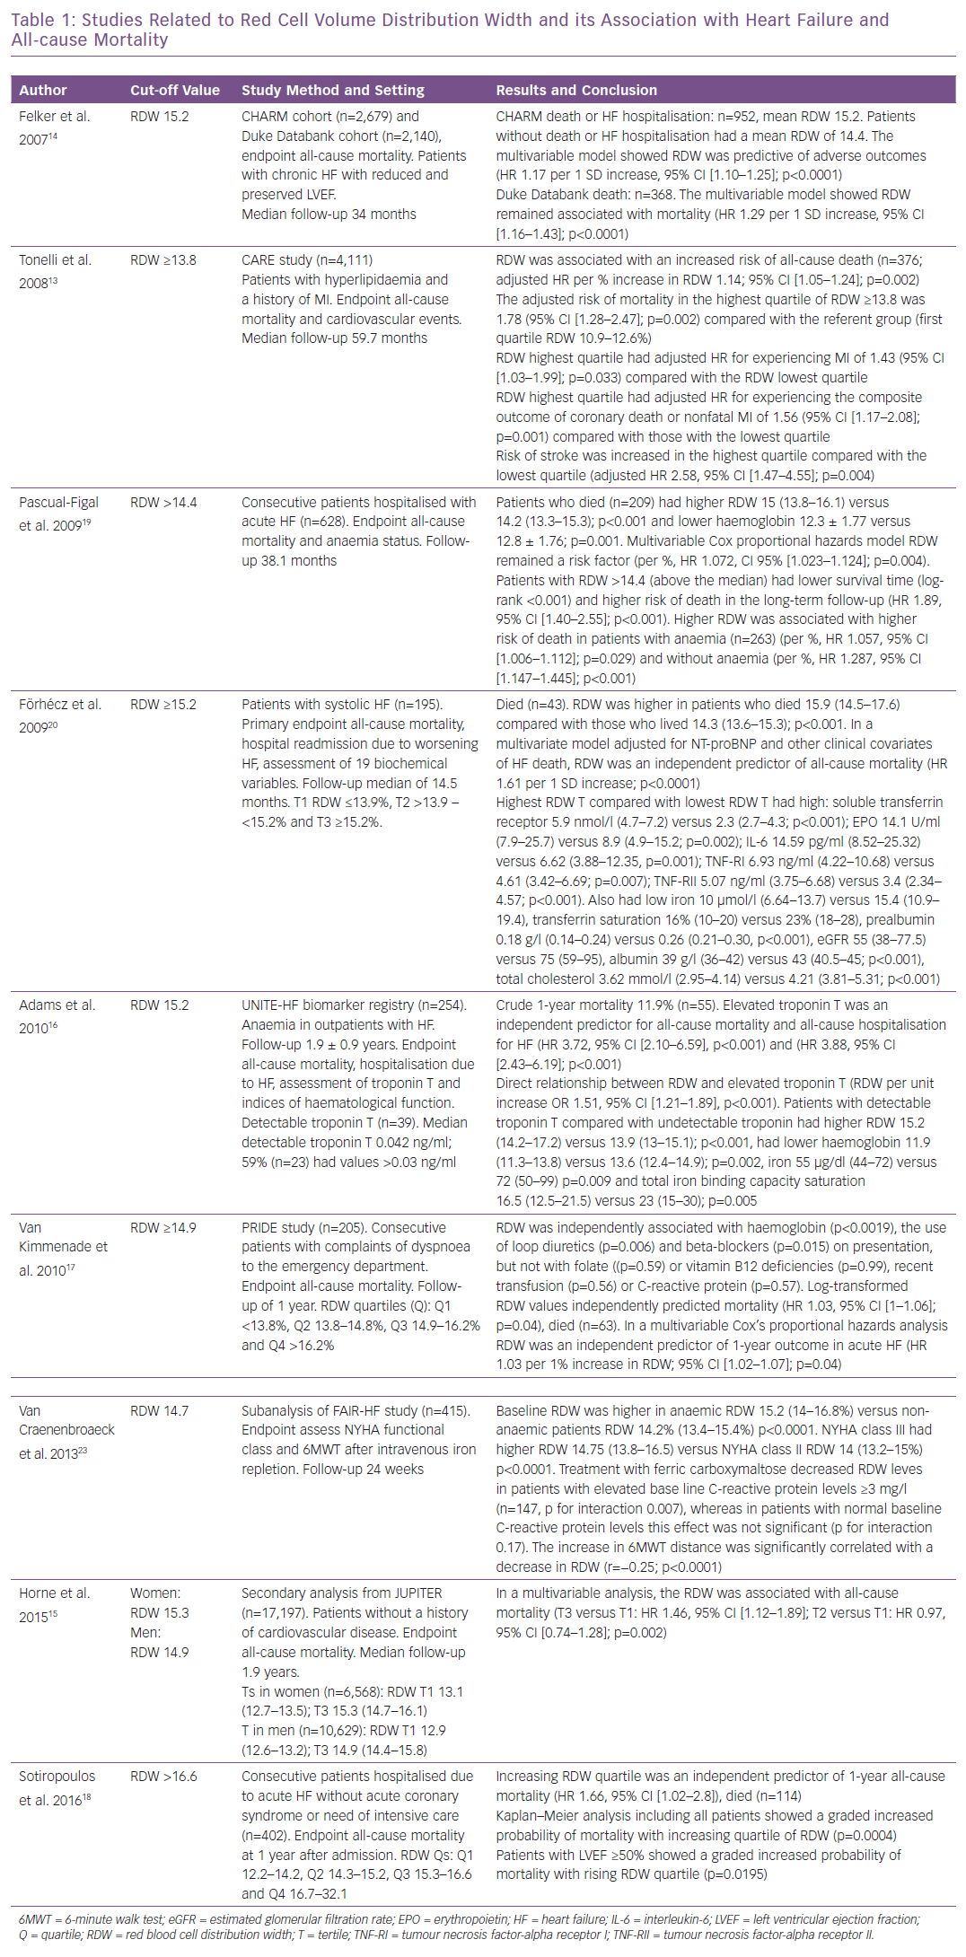
García-Escobar A, Grande Ingelmo JM
Studies Related to Red Cell Volume Distribution Width and its Association
Citation: Cardiac Failure Review 2019;5(3):176–9.
https://doi.org/10.15420/cfr.2019.13.1

