Slide 1
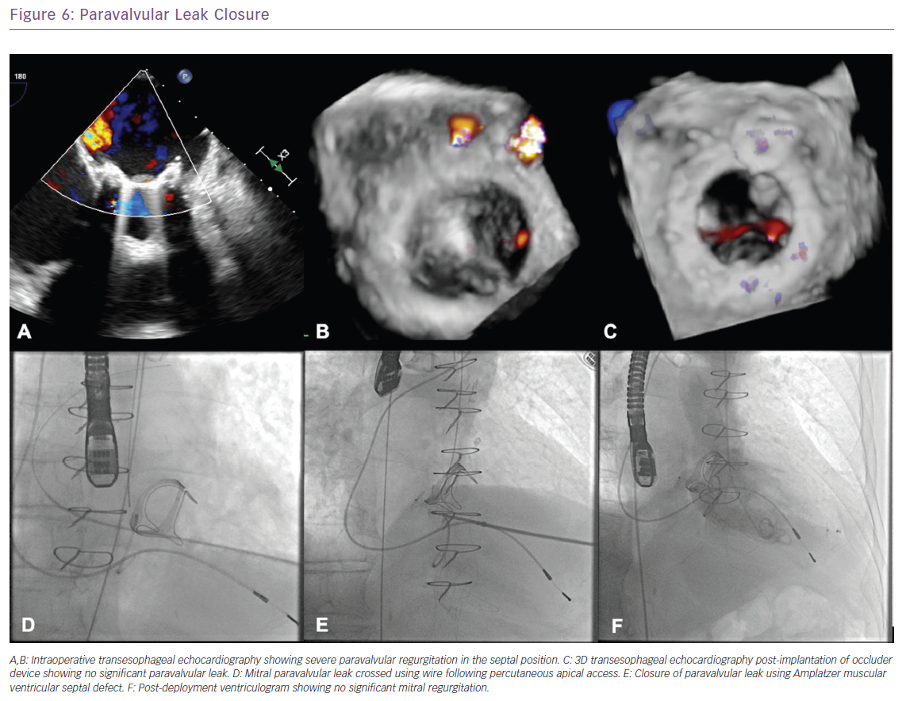
Park J, Suradi HS
Paravalvular Leak Closure
Citation: Cardiac Failure Review 2019;5(3):147–54.
https://doi.org/10.15420/cfr.2019.12.2

