Slide 1
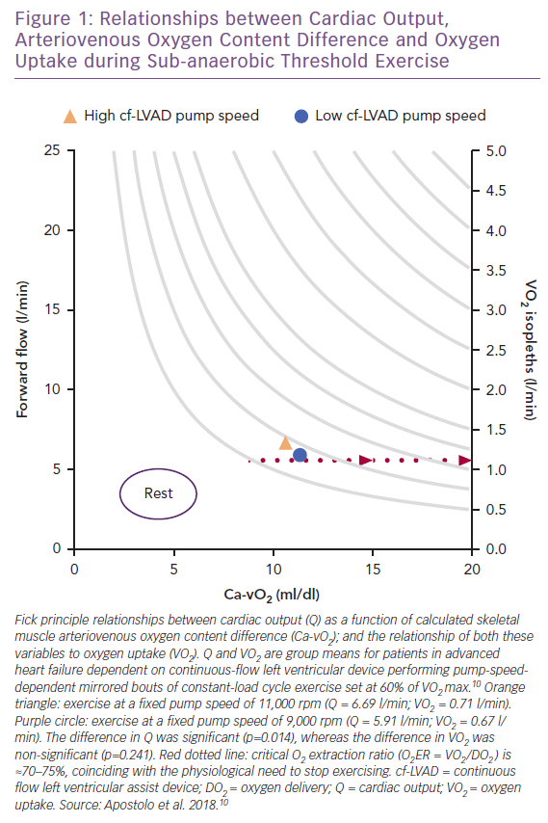
Van Iterson EH
Relationships between Cardiac Output, Arteriovenous Oxygen Content Difference and Oxygen Uptake during Sub-anaerobic Threshold Exercise
Citation: Cardiac Failure Review 2019;5(3):162–8.
https://doi.org/10.15420/cfr.2019.10.2

