Slide 1
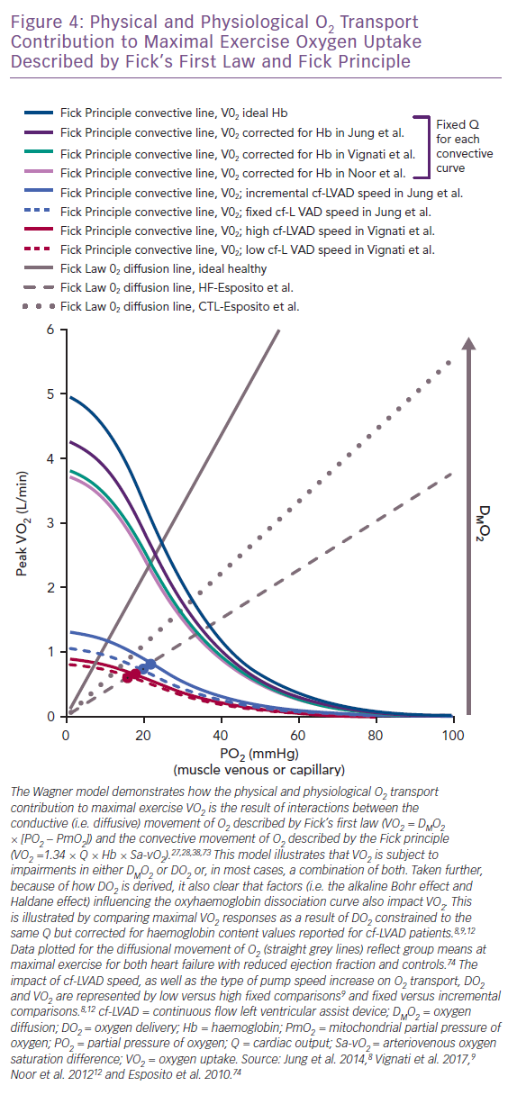
Van Iterson EH
Physical and Physiological O2 Transport Contribution to Maximal Exercise Oxygen Uptake Described by Fick’s First Law and Fick Principle
Citation: Cardiac Failure Review 2019;5(3):162–8.
https://doi.org/10.15420/cfr.2019.10.2

