Slide 1
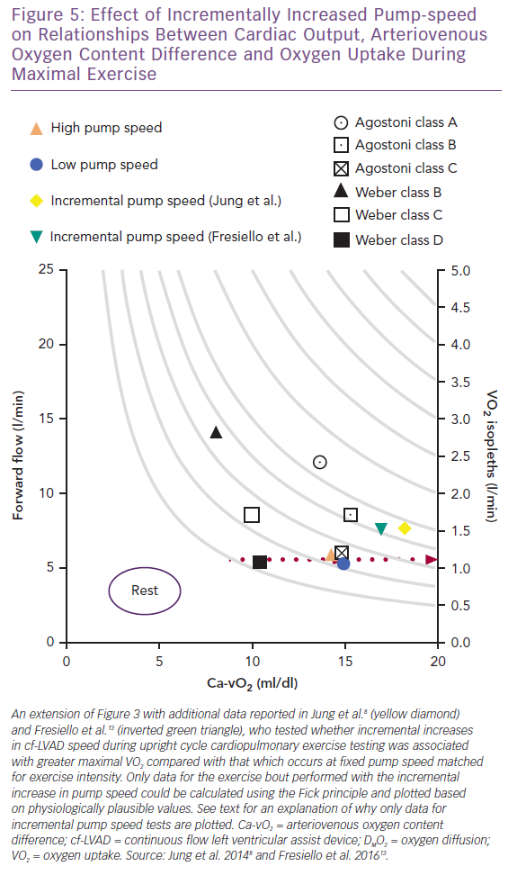
Van Iterson EH
Effect of Incrementally Increased Pump-speed on Relationships Between Cardiac Output, Arteriovenous Oxygen Content Difference and Oxygen Uptake During Maximal Exercise
Citation: Cardiac Failure Review 2019;5(3):162–8.
https://doi.org/10.15420/cfr.2019.10.2

