Slide 1
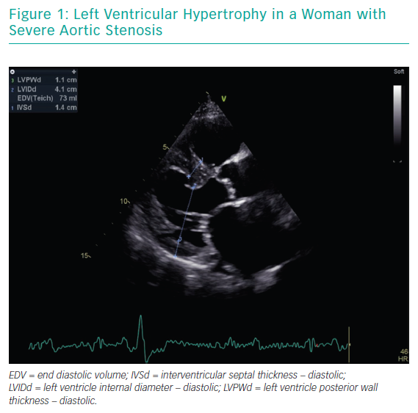
Laricchia A, Bellini B, Romano V, Khawaja S, Montorfano M, Chieffo A
Left Ventricular Hypertrophy in a Woman with Severe Aortic Stenosis
Citation: Interventional Cardiology Review 2019;14(3):137–41.
https://doi.org/10.15420/icr.2019.07.R1

