Slide 1
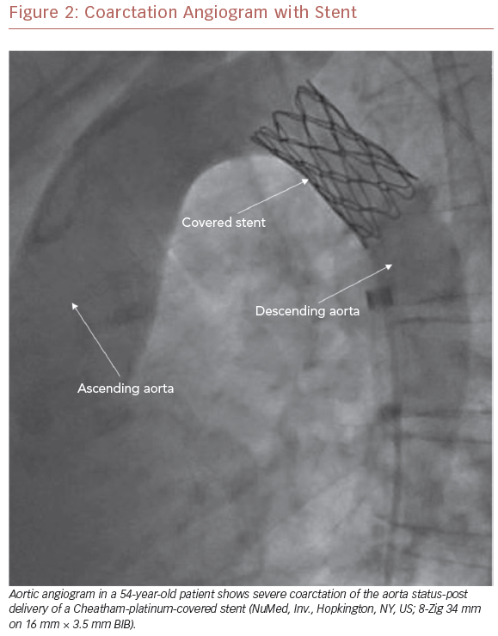
Cribbs MG
Coarctation Angiogram with Stent
Citation: US Cardiology Review 2019;13(2):99–104.
https://doi.org/10.15420/usc.2019.15.2

