Slide 1
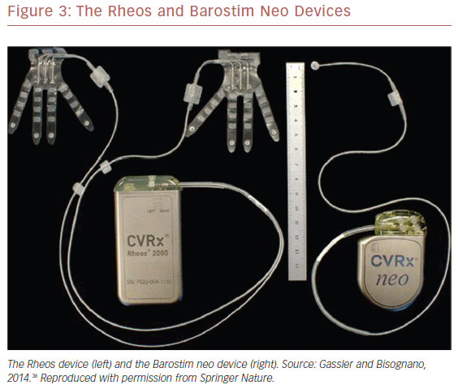
Bhatt DL, Kristensen AMD, Pareek M, Hecht Olsen M
The Rheos and Barostim Neo Devices
Citation: US Cardiology Review 2019;13(2):83–7.
https://doi.org/10.15420/usc.2019.13.2

