Slide 1
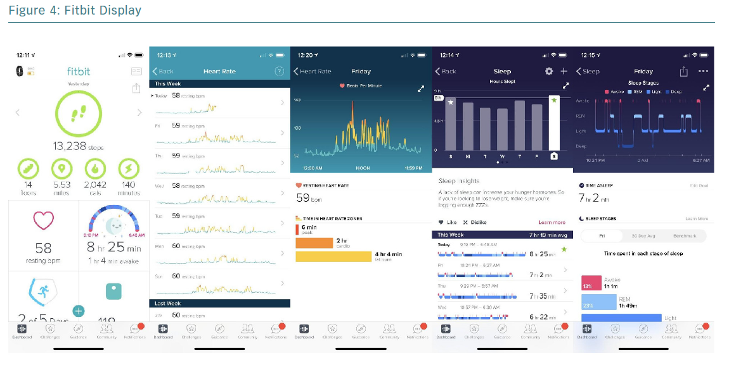
Massoomi MR, Handberg EM
Fitbit Display
Citation: European Cardiology Review 2019;14(3):181–6
https://doi.org/10.15420/ecr.2019.02

