Slide 1
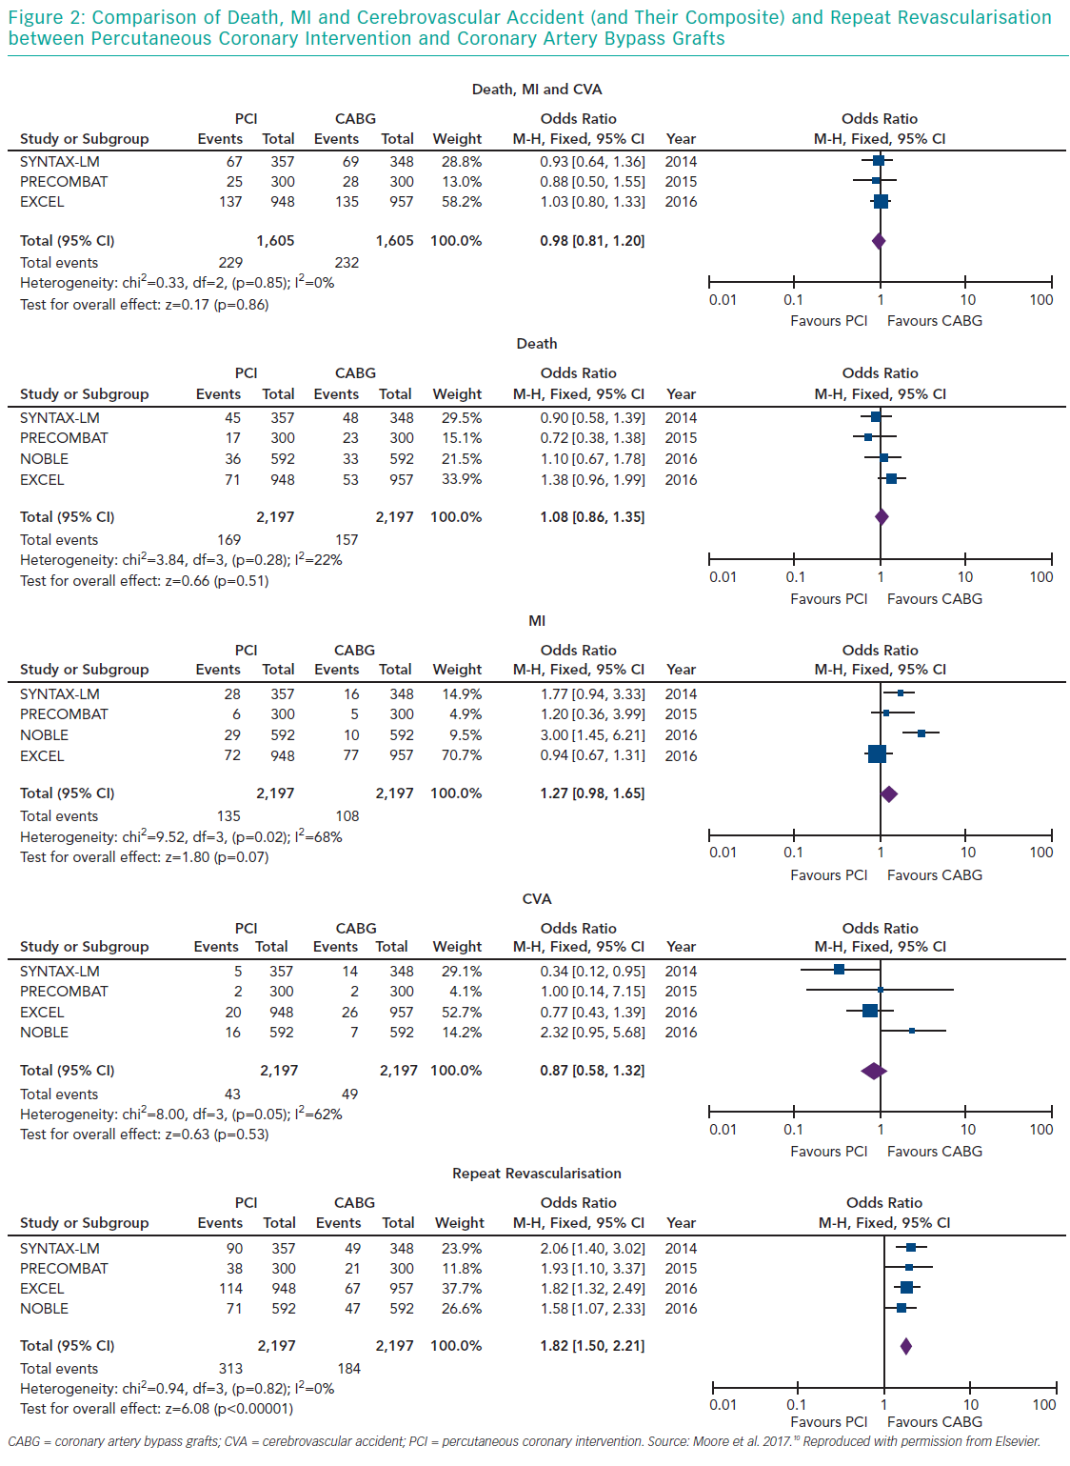
Alasnag M, Yaqoub L, Saati A, Al-Shaibi K
Comparison of Death, MI and Cerebrovascular Accident
Citation: Interventional Cardiology Review 2019;14(3):124–30.
https://doi.org/10.15420/icr.2019.10.R2

