Slide 1
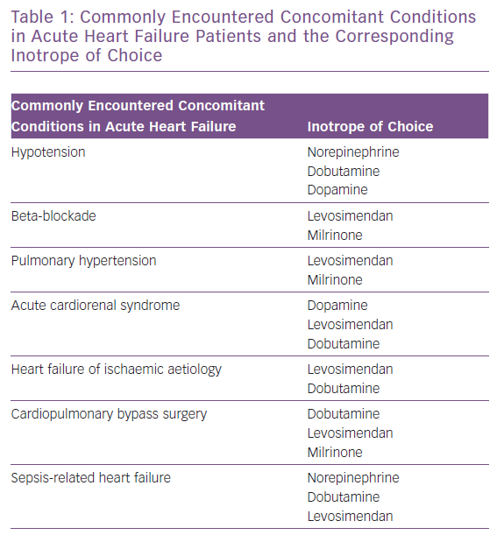
Bistola V, Arfaras-Melainis A, Polyzogopoulou E, Ikonomidis I, Parissis J
Commonly Encountered Concomitant Conditions in Acute Heart Failure Patients and the Corresponding Inotrope of Choice
Citation: Cardiac Failure Review 2019;5(3):133–9.
https://doi.org/10.15420/cfr.2019.11.2

