Slide 1

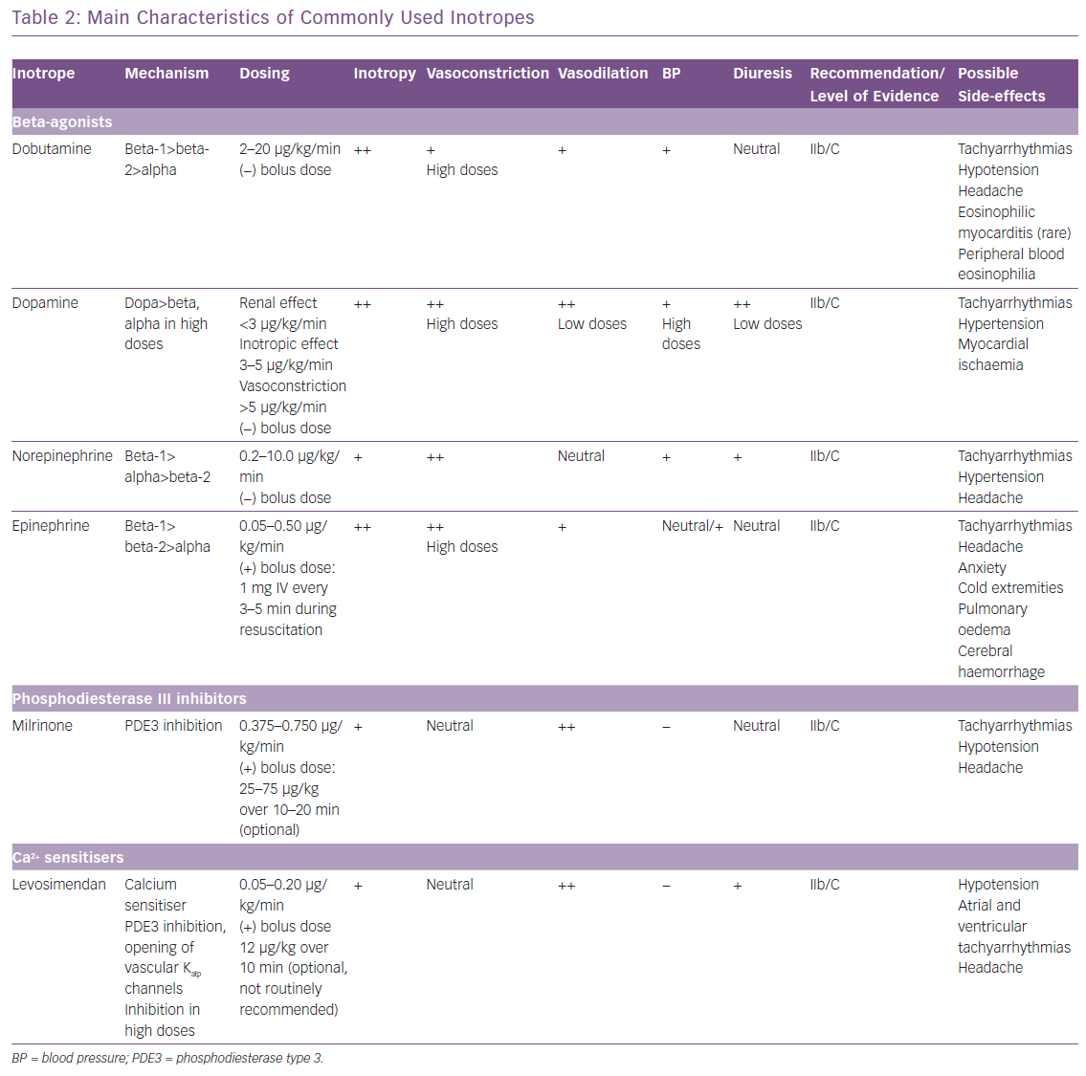
Bistola V, Arfaras-Melainis A, Polyzogopoulou E, Ikonomidis I, Parissis J
Main Characteristics of Commonly Used Inotropes
Citation: Cardiac Failure Review 2019;5(3):133–9.
https://doi.org/10.15420/cfr.2019.11.2

