Slide 1
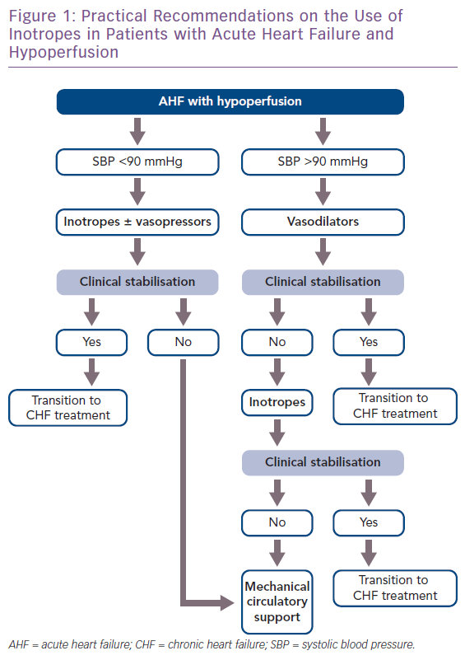
Bistola V, Arfaras-Melainis A, Polyzogopoulou E, Ikonomidis I, Parissis J
Practical Recommendations on the Use of Inotropes in Patients with Acute Heart Failure and Hypoperfusion
Citation: Cardiac Failure Review 2019;5(3):133–9.
https://doi.org/10.15420/cfr.2019.11.2

