Slide 1
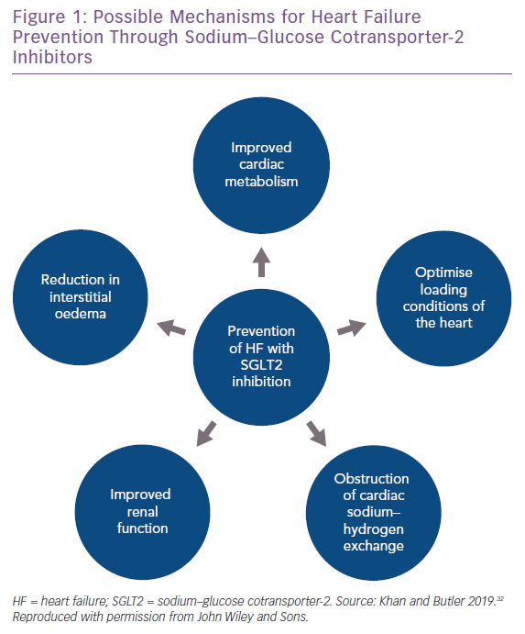
Khan MS, Butler J
Possible Mechanisms for Heart Failure Prevention Through Sodium–Glucose Cotransporter-2 Inhibitors
Citation: Cardiac Failure Review 2019;5(3):169–72.
https://doi.org/10.15420/cfr.2019.06.R1

