Slide 1
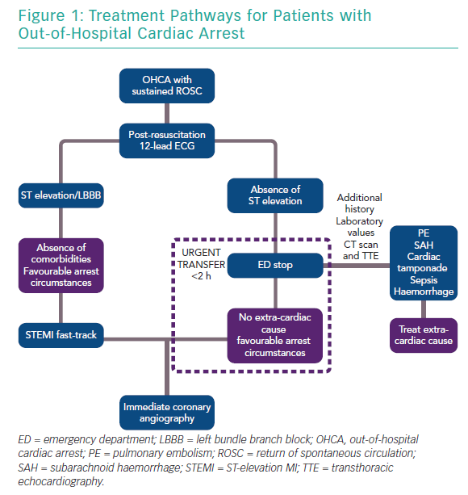
Pareek N, Kordis P, Webb I, Noc M, MacCarthy P, Byrne J
Treatment Pathways for Patients with Out-of-Hospital Cardiac Arrest
Citation: Interventional Cardiology Review 2019;14(3):113–23.
https://doi.org/10.15420/icr.2019.3.2

