Slide 1
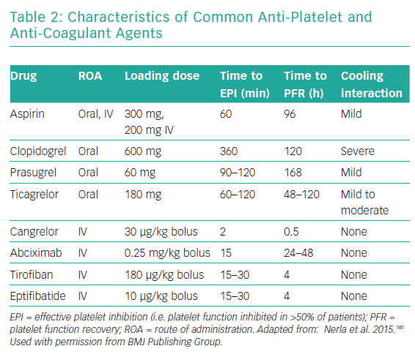
Pareek N, Kordis P, Webb I, Noc M, MacCarthy P, Byrne J
Characteristics of Common Anti-Platelet and Anti-Coagulant Agents
Citation: Interventional Cardiology Review 2019;14(3):113–23.
https://doi.org/10.15420/icr.2019.3.2

