Slide 1
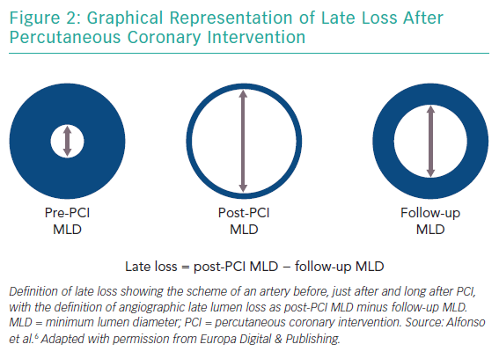
Jeger R, Nestelberger T
Graphical Representation of Late Loss After Percutaneous Coronary Intervention
Citation: Interventional Cardiology Review 2019;14(3):131–6.
https://doi.org/10.15420/icr.2019.06.R3

