Slide 1
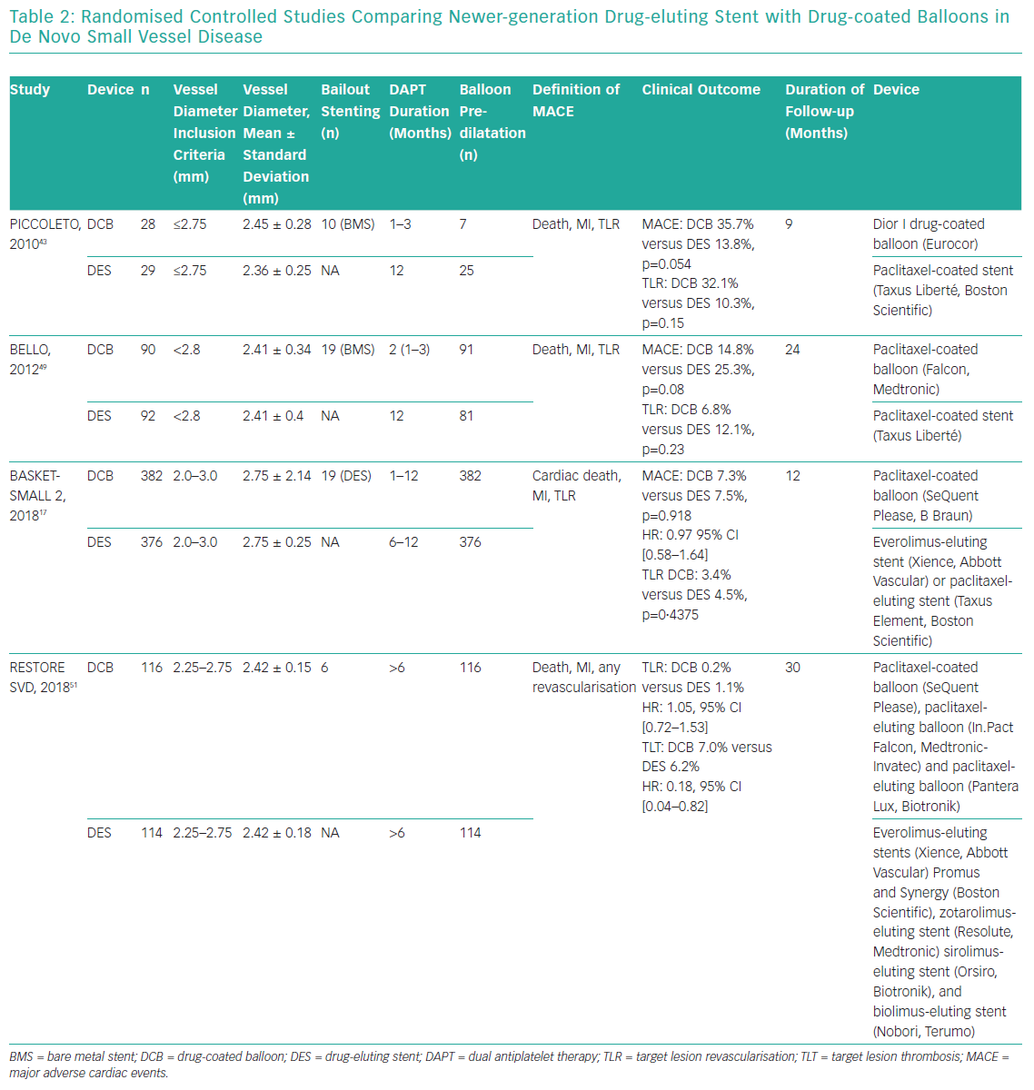
Jeger R, Nestelberger T
Randomised Controlled Studies Comparing Newer-generation Drug-eluting Stent
Citation: Interventional Cardiology Review 2019;14(3):131–6.
https://doi.org/10.15420/icr.2019.06.R3

