Slide 1
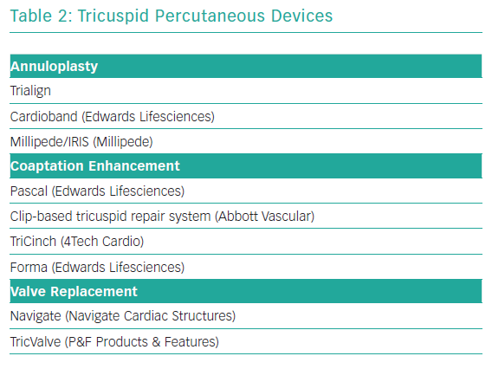
Erlebach M, Lange R
Tricuspid Percutaneous Devices
Citation: Interventional Cardiology Review 2019;14(3):142–6.
https://doi.org/10.15420/icr.2019.13.R1

