Slide 1
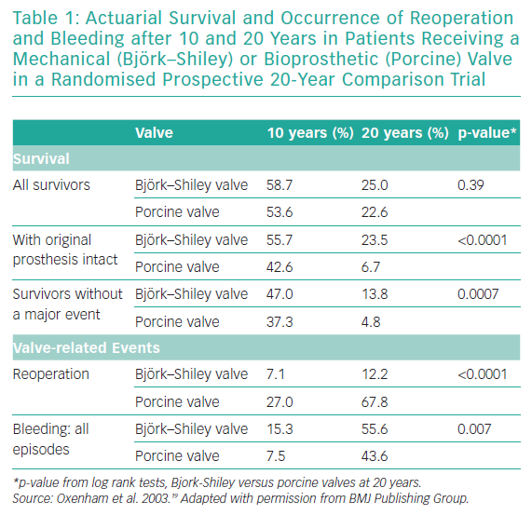
O’Donnell JP, O'Sullivan CJ
Actuarial Survival and Occurrence of Reoperation and Bleeding
Citation: Interventional Cardiology Review 2019;14(3):147–51.
https://doi.org/10.15420/icr.2019.08.R2

