Slide 1
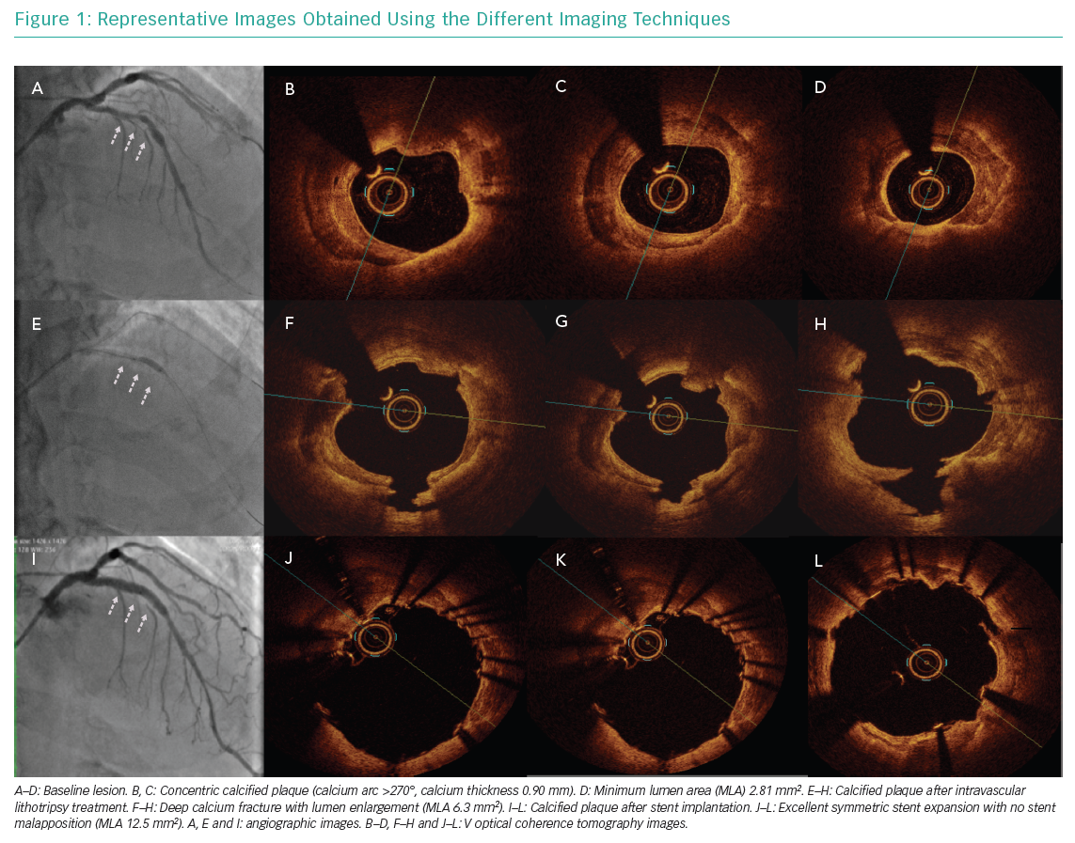
Dini CS, Nardi G, Ristalli F, Mattesini A, Hamiti B, Di Mario C
Representative Images Obtained Using the Different Imaging Techniques
Citation: Interventional Cardiology Review 2019;14(3):154–63.
https://doi.org/10.15420/icr.2019.19.R1

