Slide 1
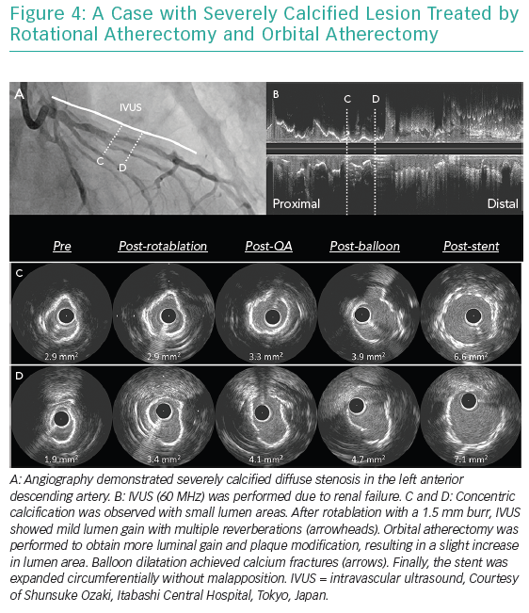
Ueki Y, Otsuka T, Hibi K, Räber L
A Case with Severely Calcified Lesion
Citation: Interventional Cardiology Review 2019;14(3):164–8.
https://doi.org/10.15420/icr.2019.16.R1

