Slide 1
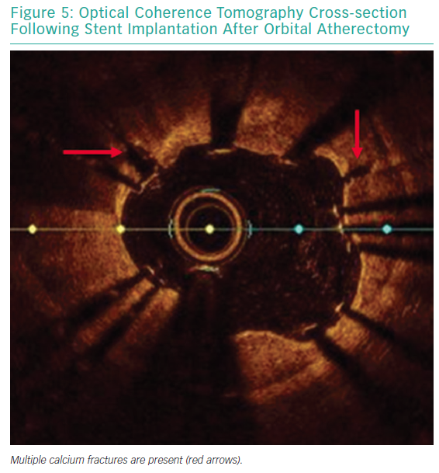
Shlofmitz E, Jeremias A, Shlofmitz RA, Ali ZA
Optical Coherence Tomography Cross-section
Citation: Interventional Cardiology Review 2019;14(3):169–73.
https://doi.org/10.15420/icr.2019.20.R1

