Slide 1
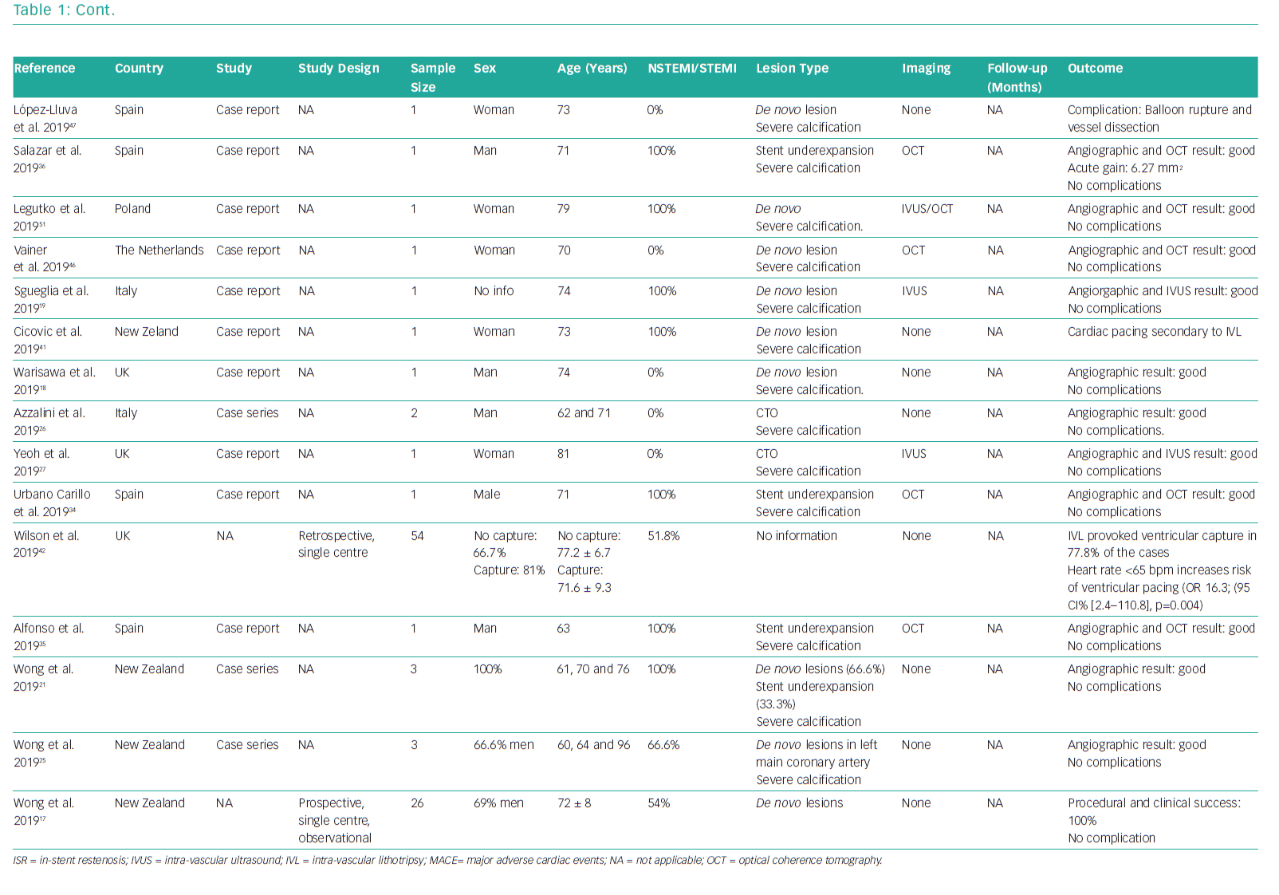
Daemen J, Tovar Forero MN
Studies on Coronary Intravascular Lithotripsy
Citation: Interventional Cardiology Review 2019;14(3):174–81.
https://doi.org/10.15420/icr.2019.18.R1

