Slide 1
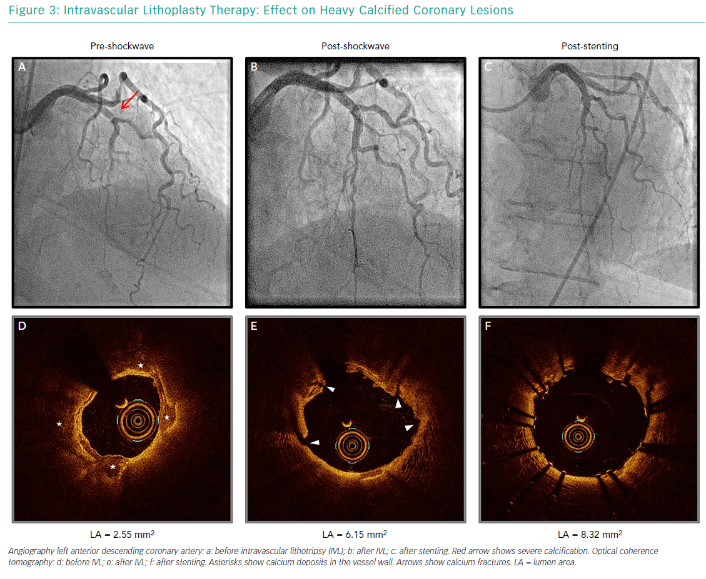
Daemen J, Tovar Forero MN
Intravascular Lithoplasty Therapy: Effect on Heavy Calcified Coronary Lesions
Citation: Interventional Cardiology Review 2019;14(3):174–81.
https://doi.org/10.15420/icr.2019.18.R1

