Slide 1

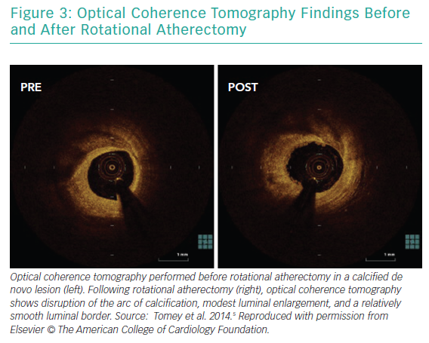
Gupta T, Weinreich M, Greenberg M, Colombo A, Latib A
Optical Coherence Tomography Findings Before and After Rotational Atherectomy
Citation: Interventional Cardiology Review 2019;14(3):182–9.
https://doi.org/10.15420/icr.2019.17.R1

