Slide 1
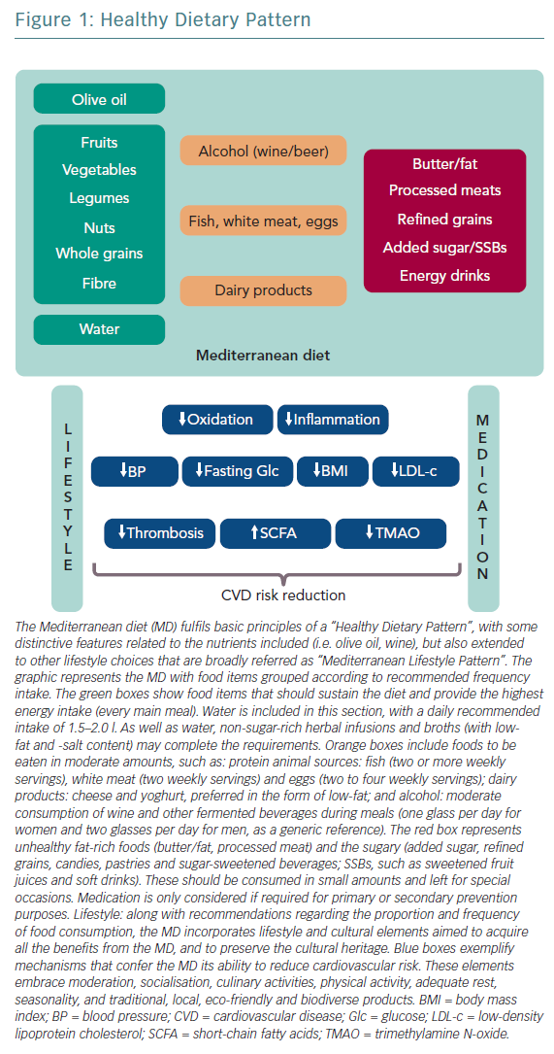
Carro A, Panisello JM
Healthy Dietary Pattern
Citation: European Cardiology Review 2019;14(3):141–50
https://doi.org/10.15420/ecr.2019.07

