Slide 1
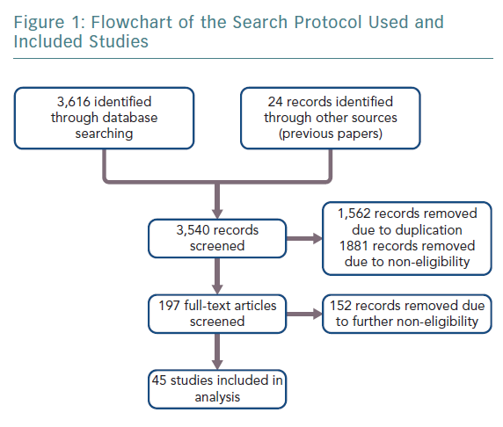
Schnaubelt S, Hammer A, Koller L, Niederdoeckl J, Kazem N, Spiel A, Niessner A, Sulzgruber P
Flowchart of the Search Protocol Used and Included Studies
Citation: European Cardiology Review 2019;14(3):161–4
https://doi.org/10.15420/ecr.2019.21.2

