Slide 1
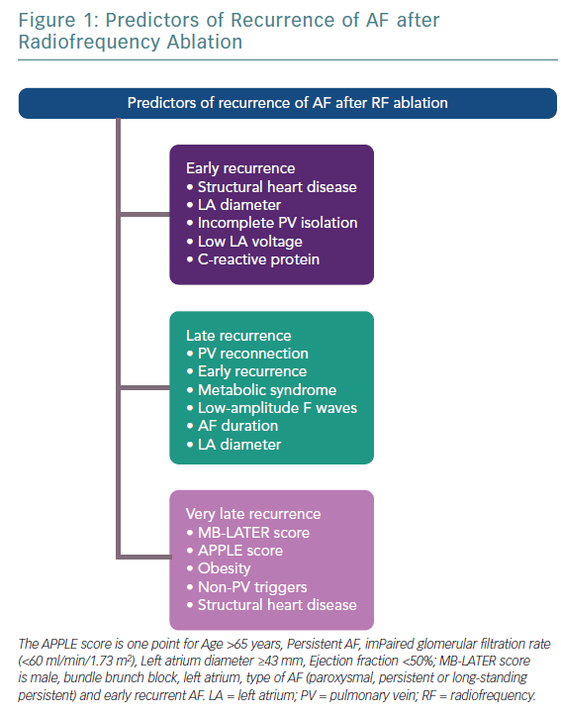
Garvanski I, Simova I, Angelkov L, Matveev M
Predictors of Recurrence of AF after Radiofrequency Ablation
Citation: European Cardiology Review 2019;14(3):165–8
https://doi.org/10.15420/ecr.2019.30.2

