Slide 1
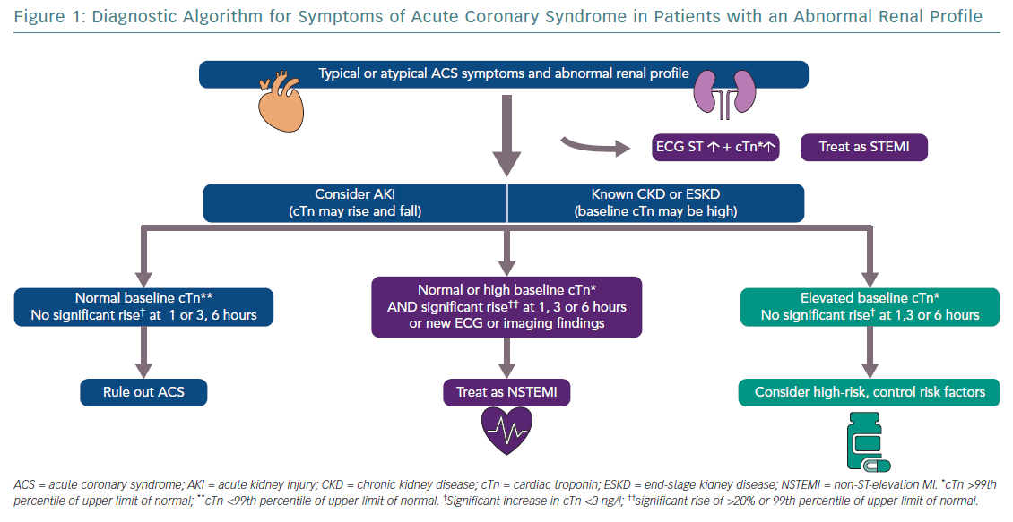
Banerjee D, Perrett C, Banerjee A
Diagnostic Algorithm for Symptoms of Acute Coronary Syndrome
Citation: European Cardiology Review 2019;14(3):187–90
https://doi.org/10.15420/ecr.2019.28.2

