Slide 1
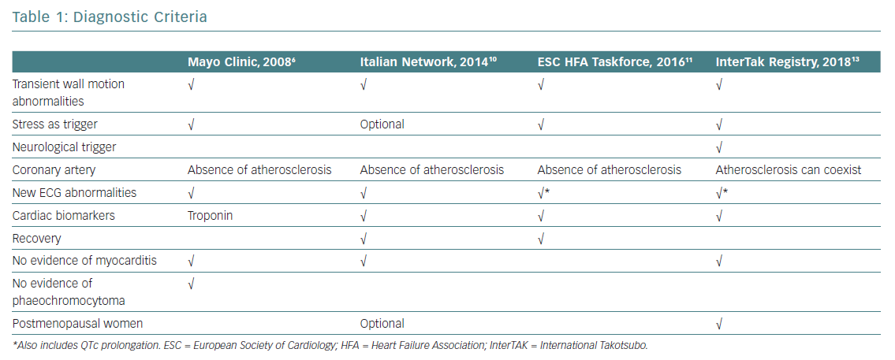
Filippo CD, Bacchi B, Di Mario C
Diagnostic Criteria
Citation: European Cardiology Review 2019;14(3):191–6
https://doi.org/10.15420/ecr.2019.27.3

