Slide 1
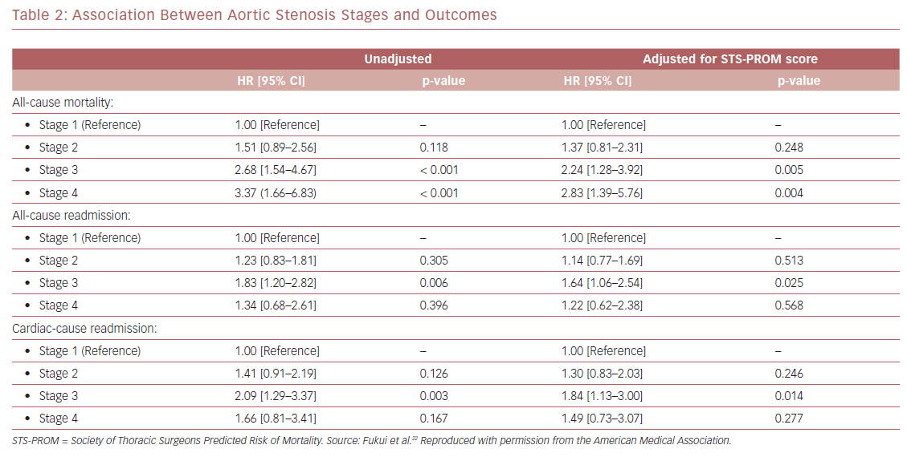
Fukui M, Cavalcante JL
Association Between Aortic Stenosis Stages and Outcomes
Citation: US Cardiology Review 2019;13(2):69–73.
https://doi.org/10.15420/usc.2019.9.1

