Slide 1
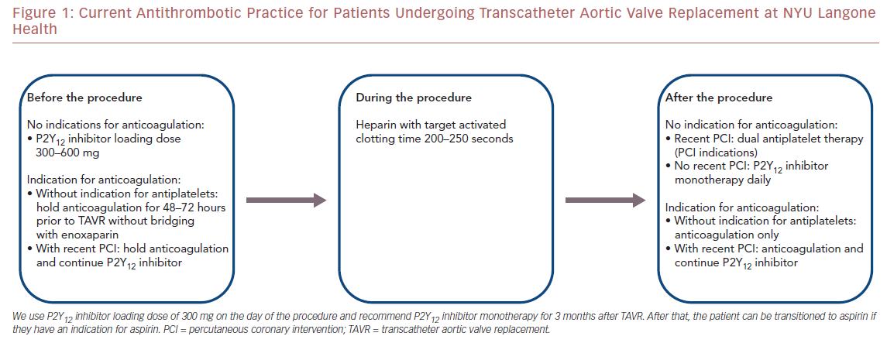
Williams MR, Grossman K, Ibrahim H
Figure 1: Current Antithrombotic Practice for Patients Undergoing Transcatheter
Citation: US Cardiology Review 2019;13(2):88–93.
https://doi.org/10.15420/usc.2019.01

