Slide 1
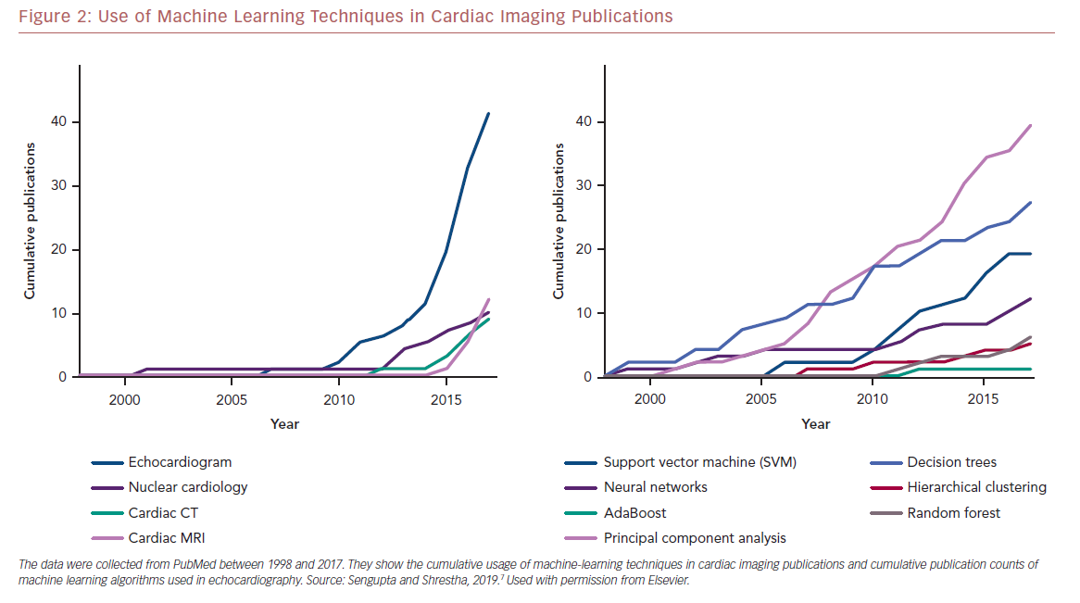
Seetharam K, Shrestha S, Sengupta PP
Use of Machine Learning Techniques in Cardiac Imaging Publications
Citation: US Cardiology Review 2019;13(2):110–6.
https://doi.org/10.15420/usc.2019.19.2

