Slide 1

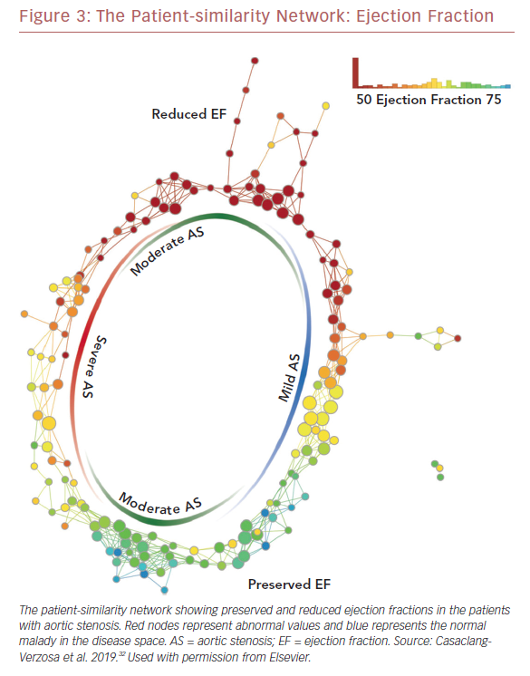
Seetharam K, Shrestha S, Sengupta PP
The Patient-similarity Network: Ejection Fraction
Citation: US Cardiology Review 2019;13(2):110–6.
https://doi.org/10.15420/usc.2019.19.2

