Slide 1
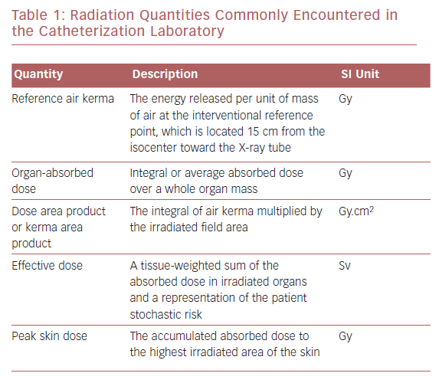
Padmanabhan D, Shankar S, Chandrashekharaiah A, Deshpande S
Radiation Quantities Commonly Encountered in the Catheterization Laboratory
Citation: US Cardiology Review 2019;13(2):117–22.
https://doi.org/10.15420/usc.2019.21.2

