Slide 1
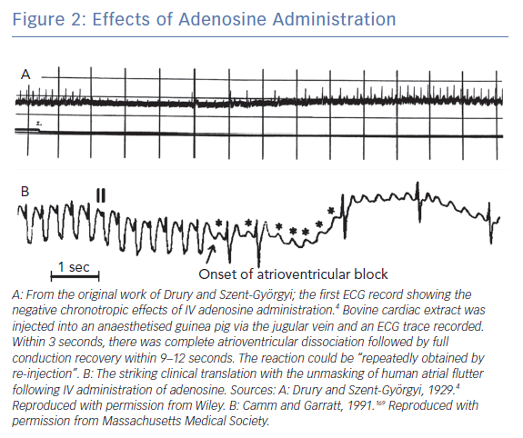
Matthews GD, Grace AA
Effects of Adenosine Administration
Citation: Arrhythmia & Electrophysiology Review 2019;8(4):240–8.
https://doi.org/10.15420/aer.2019.05

