Slide 1
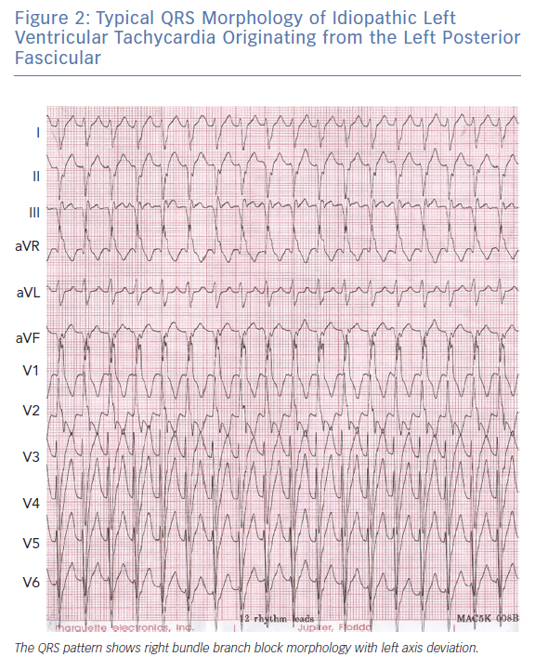
Chen H, Chan K, Po SS, Chen M
Typical QRS Morphology of Idiopathic Left Ventricular Tachycardia Originating from the Left Posterior Fascicular
Citation: Arrhythmia & Electrophysiology Review 2019;8(4):249–54.
https://doi.org/10.15420/aer.2019.07

