Slide 1
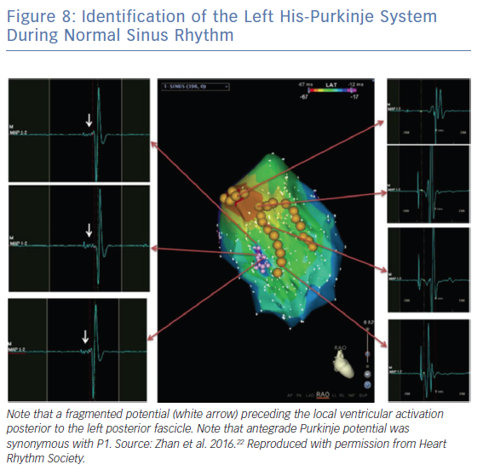
Chen H, Chan K, Po SS, Chen M
Identification of the Left His-Purkinje System During Normal Sinus Rhythm
Citation: Arrhythmia & Electrophysiology Review 2019;8(4):249–54.
https://doi.org/10.15420/aer.2019.07

