Slide 1
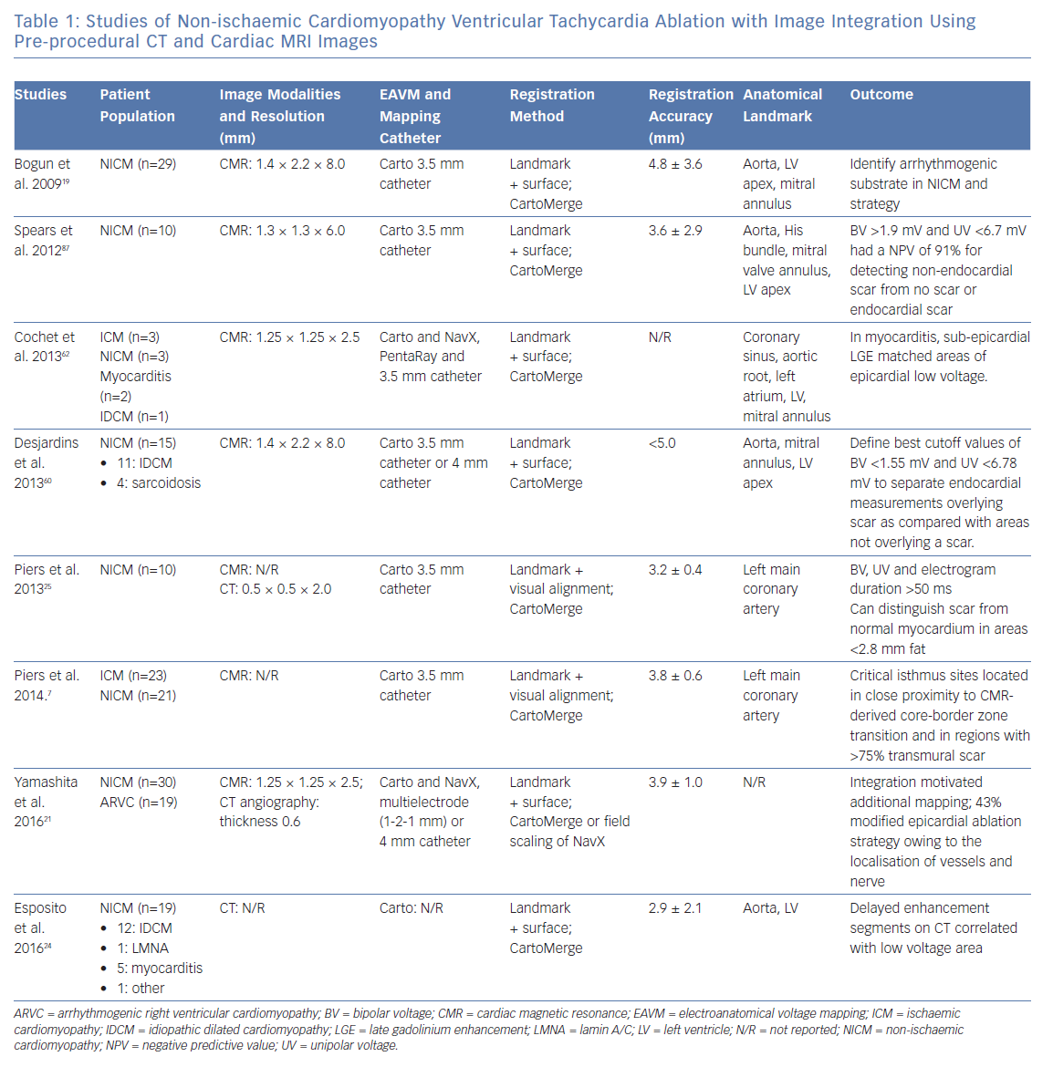
Kuo L, Liang JJ, Nazarian S, Marchlinski FE
Studies of Non-ischaemic Cardiomyopathy Ventricular Tachycardia
Citation: Arrhythmia & Electrophysiology Review 2019;8(4):255–64.
https://doi.org/10.15420/aer.2019.37.3

