Slide 1
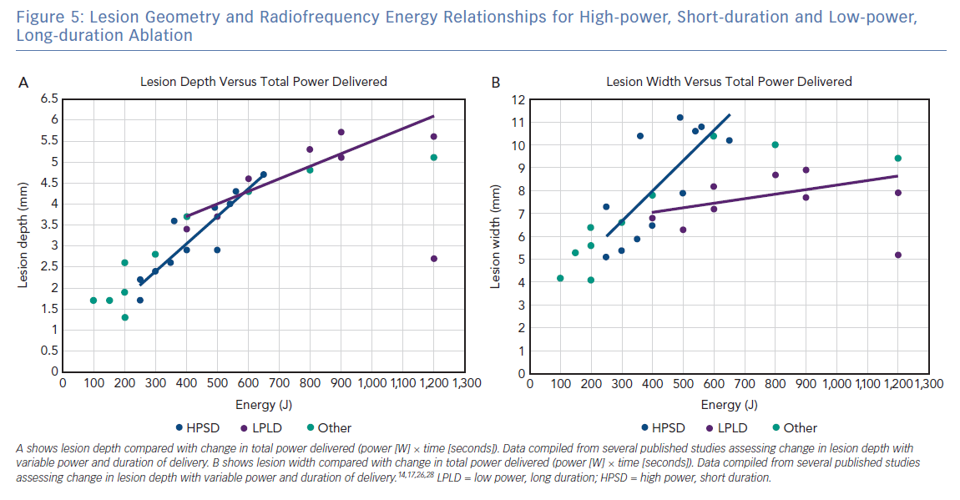
Kotadia ID, Williams SE, O’Neill M
Lesion Geometry and Radiofrequency Energy Relationships
Citation: Arrhythmia & Electrophysiology Review 2019;8(4):265–72.
https://doi.org/10.15420/aer.2019.09

