Slide 1
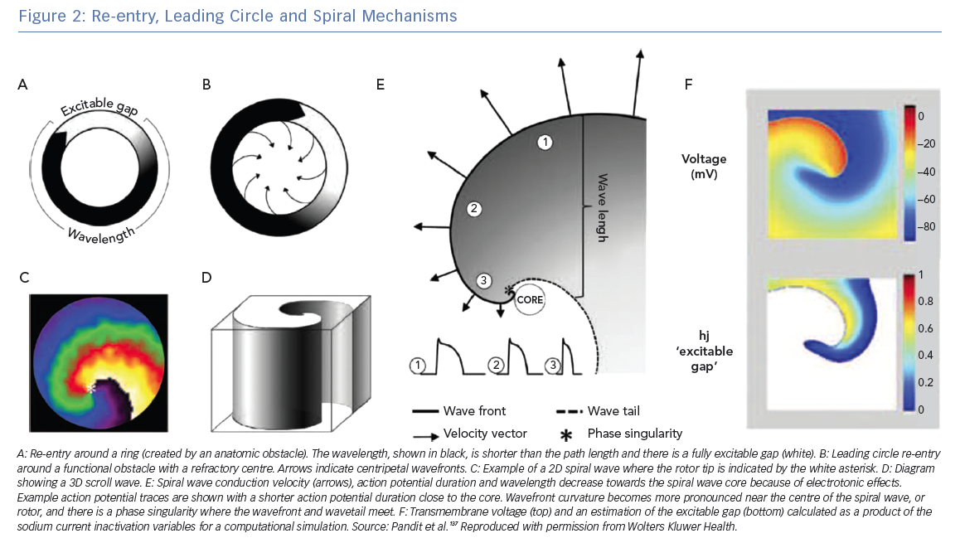
Roney CH, Wit AL, Peters NS
Re-entry, Leading Circle and Spiral Mechanisms
Citation: Arrhythmia & Electrophysiology Review 2019;8(4):273–84.
https://doi.org/10.15420/aer.2019.08

