Slide 1
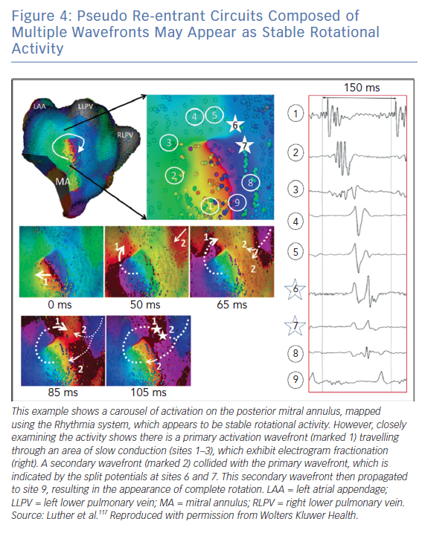
Roney CH, Wit AL, Peters NS
Pseudo Re-entrant Circuits Composed of Multiple Wavefronts May Appear as Stable Rotational Activity
Citation: Arrhythmia & Electrophysiology Review 2019;8(4):273–84.
https://doi.org/10.15420/aer.2019.08

