Slide 1

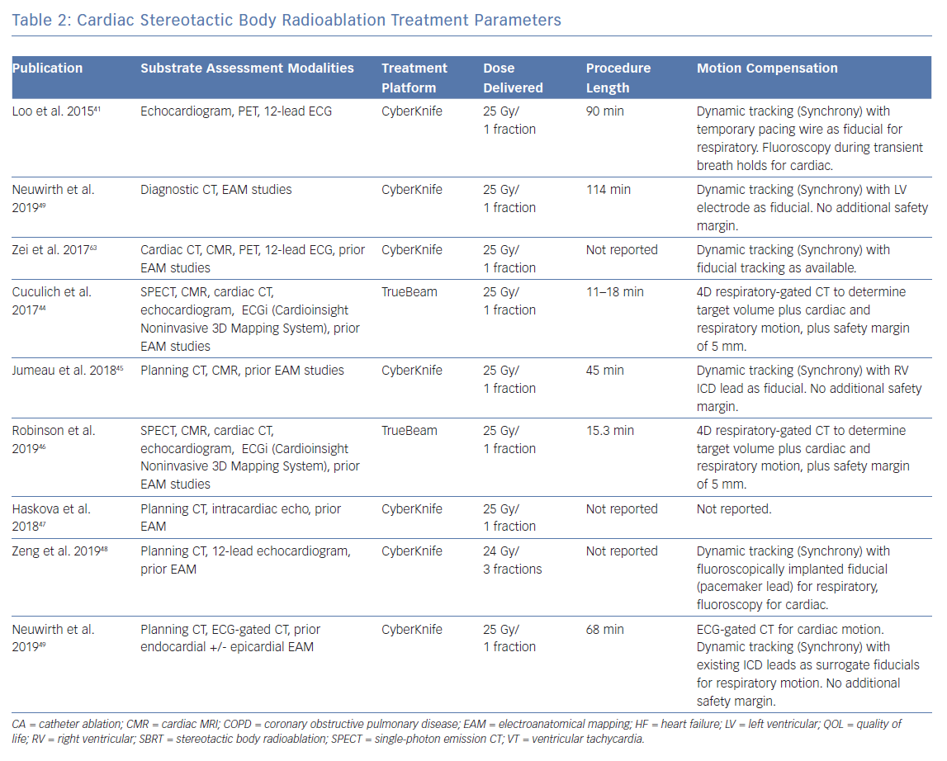
Wei C, Qian P, Tedrow UB, Mak R, Zei PC
Cardiac Stereotactic Body Radioablation Treatment Parameters
Citation: Arrhythmia & Electrophysiology Review 2019;8(4):285–93.
https://doi.org/10.15420/aer.2019.04

