Slide 1
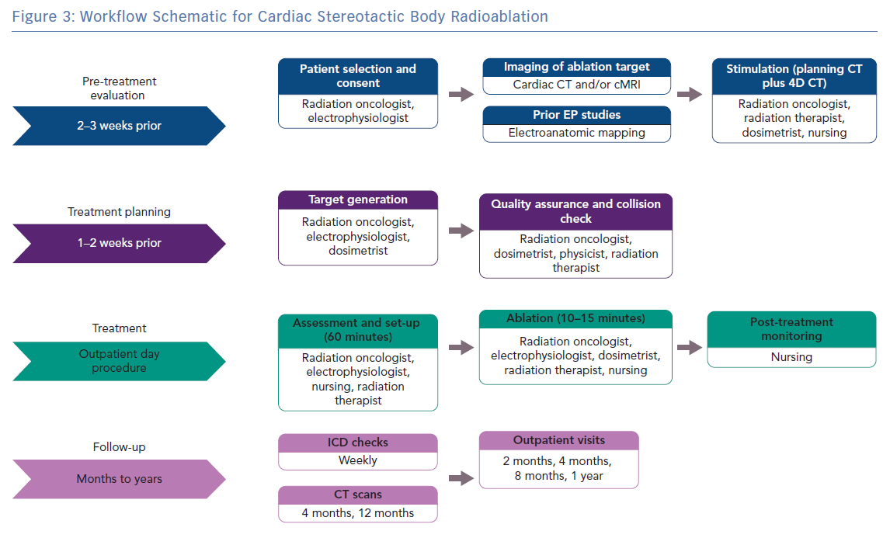
Wei C, Qian P, Tedrow UB, Mak R, Zei PC
Workflow Schematic for Cardiac Stereotactic Body Radioablation
Citation: Arrhythmia & Electrophysiology Review 2019;8(4):285–93.
https://doi.org/10.15420/aer.2019.04

